Slide 1
A Modern Approach to Estimating Impact on Aquatic Populations from Entrainment at Hydroelectric Facilities: Fish Entrainment Risk Assessment (FERA)
Kevin Nebiolo PhD.
Alice Shelly
January, 2023

Slide 2
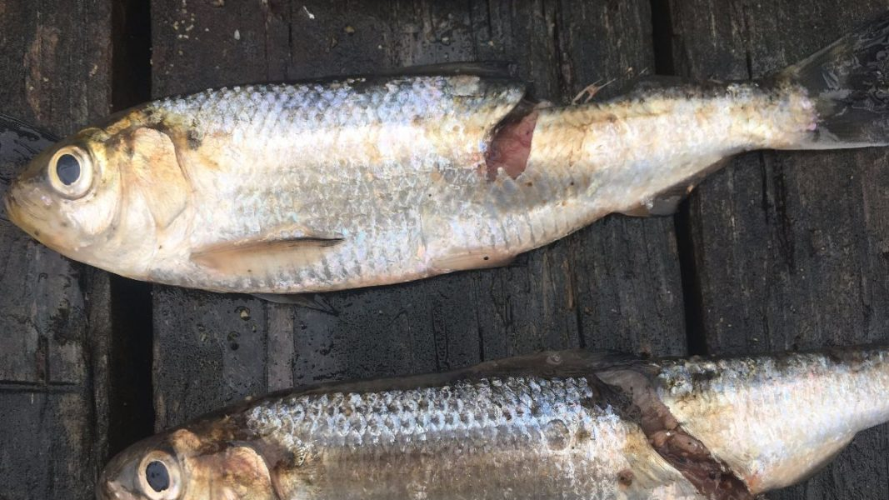
Introduction
Obligate and opportunistic migrants risk entrainment at hydroelectric facilities as they move downstream
Entrained fish are exposed to turbine passage mortality stressors
Mortality rates and entrainment rates are separately well studied phenomena but their cumulative effects on populations are not
Managers need a quantitative measure that assesses entrainment risk

Slide 3
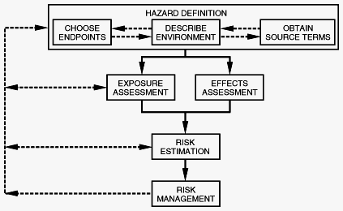
Ecological Risk Assessment
Two components
Exposure: anticipate the magnitude and frequency of potential future entrainment mortality events
Effects: assess the resiliency of the impacted populations
A population is resilient if it can replace those lost to entrainment
https://www.esd.ornl.gov/iab/iab6-2.htm

Slide 4
Existing Entrainment Estimators
Traditional methods produce single point estimate with no uncertainty
Multiply entrainment rate (fish per unit volume) by the total volume of water discharged through a facility within some unit of time (day, week, or month)
But entrainment rates are highly variable with infrequent large events…
Two Potential Problems:
1. If a large episodic event occurs while sampling, the estimate will be biased as this high rate is applied across an entire interval of time
2. Likewise, if no large event occurs while sampling the estimate may incorrectly characterize the facility as having little to no impact

Slide 5



Motivation
Existing methods either don’t incorporate or incorrectly incorporate measures of uncertainty
Entrainment estimates fall short of estimating population level impacts
Develop a transparent, repeatable, and objective method, and release as open-source software under MIT license so others can use, improve, and contribute toward its development

Slide 6
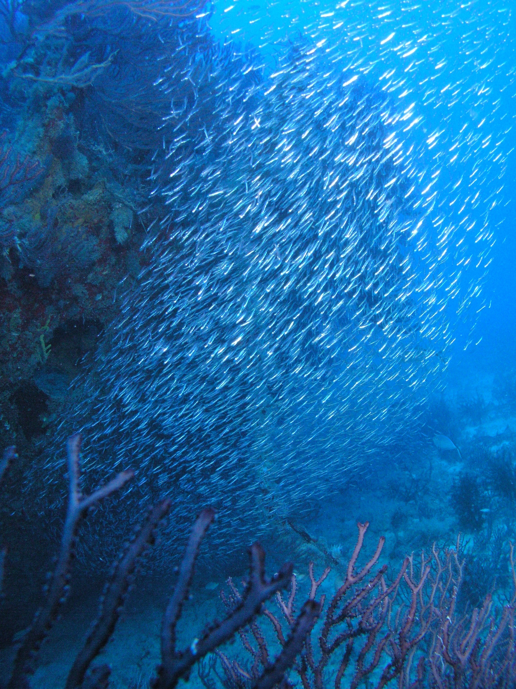
stryke.py
Individual based model – follows the fate of individual fish in a simulated population as they migrate through a hydroelectric facility
Population size, individual lengths, movement, and survival are simulated with Monte Carlo methods
Python 3.7.x with MS Excel interface

Slide 7
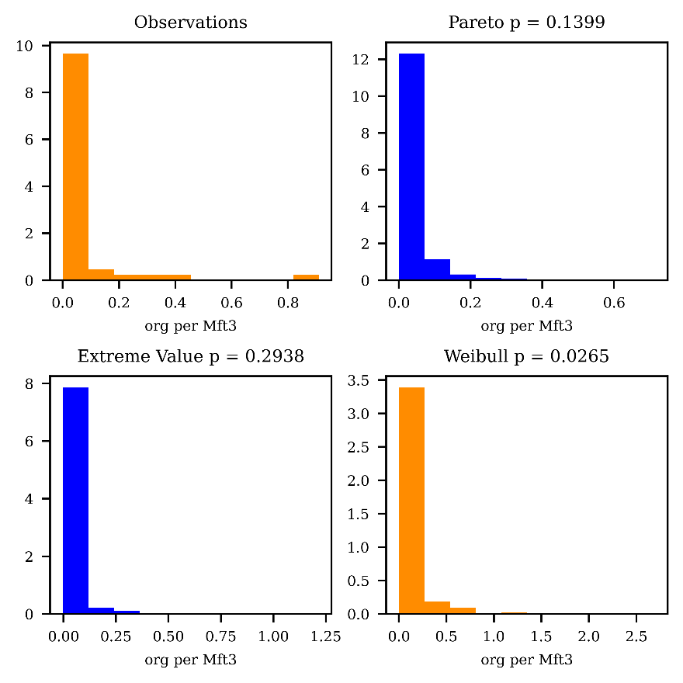
Methods – Describing Entrainment Events
EVT not CLT
Stryke simulates the magnitude and frequency of entrainment events by sampling from distributions fit to empirical observations
Database of monthly observations from 73 facilities (EPRI 1997)
Normalized for discharge: fish per Mft³
Pattern repeated across species and regions
how big can an event get and how frequently do they occur?

Slide 8
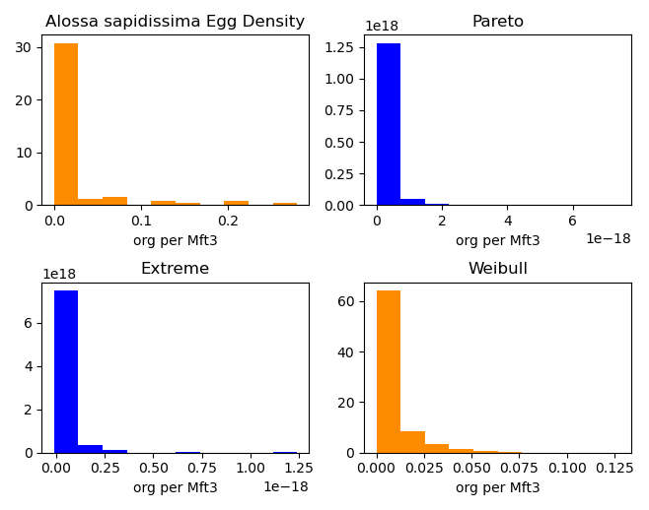
Pattern describes impact across all life stages
Alosa sapidissima Egg / Mft³ - pumped storage facility

Slide 9
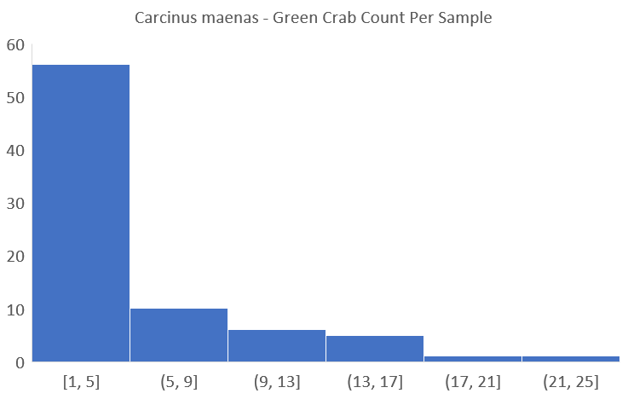
Pattern also describes impact to much different species
Green crab count per impingement sample – cooling water intake

Slide 10
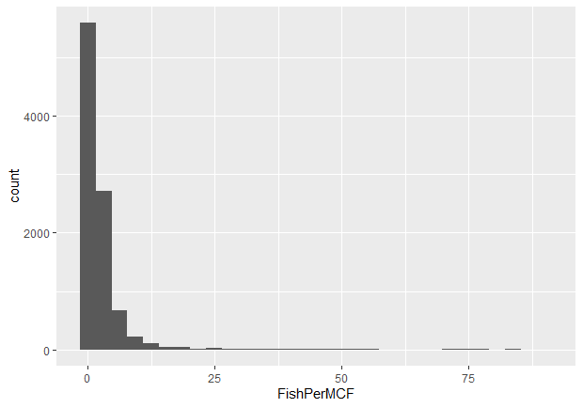
Pattern exists with different observation techniques
Fish Mft³ – acoustic imaging camera at pumped storage intake

Slide 11
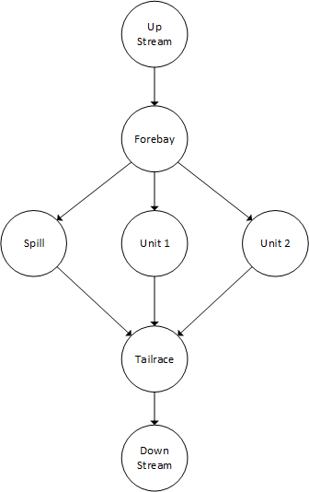
Methods – Movement and Migration
Individuals move between nodes in a network
Possible to chain multiple facilities together
If we know the overall discharge and how each unit operates, we can route water through the network
Assume fish ‘follow the flow’
If fish survive current node they move to the next
Draw from multinomial probability distribution controls where fish move

Slide 12
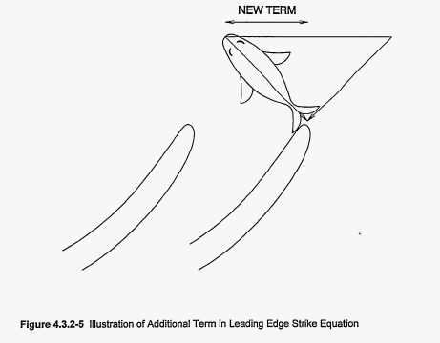
Methods – Simulating Survival
At all nodes except turbines, survival simulated with rates determined a priori
For entrained fish, survival assessed with Franke et. al. 1997 equations
If we know the length of a given fish, the amount of discharge, the type of turbine, the number of blades, and how fast it rotates, we can calculate with certainty the probability of being struck
Therefore: the only morphometric parameter that influences survival is length
*For most species – this isn’t the case with Am. Eel
Franke et. al. 1997

Slide 13
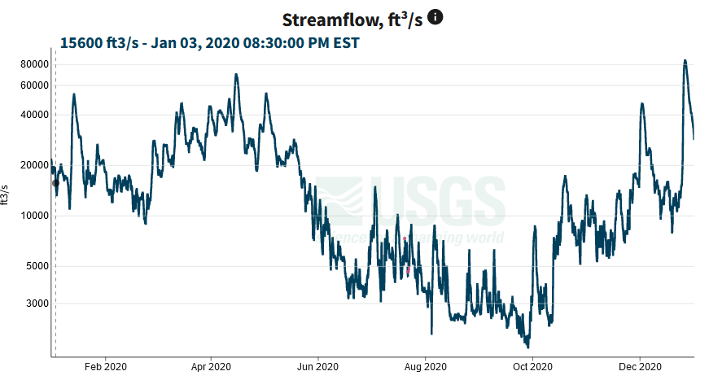
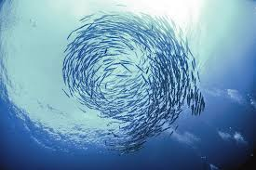
Yearly Entrainment Estimate (Impact)
Simulate presence
If present simulate entrainment event
For every fish in event, simulate movement and survival
$$Σ$$
Σ
For every day in a hydrograph
X 1000’s

Slide 14
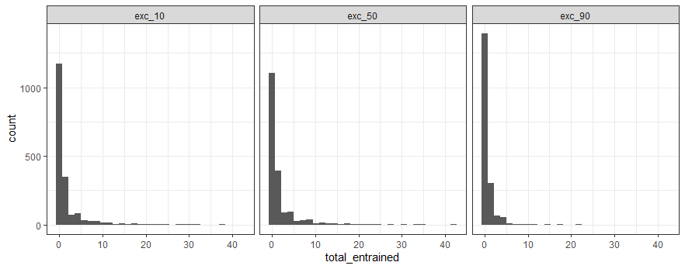
Typical Simulation Results
Table of survival rates (mean, 95% CI beta distribution) by species and location
Daily Summary: discharge, population, number entrained, number killed
Yearly Summary: median population, median entrained, median killed, likelihood 10, 100, or 1000 fish entrained, likelihood 10, 100, 1000 fish killed
Table of proportion survived or killed by species, season, location, and length

Slide 15
Discussion/Conclusion/Next Steps
FERA offers a transparent, objective, repeatable, and scalable method of assessing impacts to aquatic populations
Entrainment data getting dated (90’s) need recent studies
Blade strike validated with USFWS TBSM
Expand turbine survival functions
Gomes and Larinier – European eel Kaplan
metanalysis of balloon tag studies, - all species, especially Am. Eel
potential collaboration with other researchers (Alden?, PNNL?)
Blade strike model for American eel not accurate
Modeling could be extended to once through cooling and pumped storage facilities with expansion of database
Stryke can be parameterized for anadromous species to study effects from cumulative stressors and delay

Slide 16
Questions?
Check it out today
https://github.com/knebiolo/stryke
If you are interested in contributing, send an email to:
Kevin.Nebiolo@kleinschmidtgroup.com

